Slide 1

SALES OPPORTUNITY - Every deal counts

Slide 2
Showcasing team members:
Denis Samoilov
Nastya Zaytsev
Moshe Budaki
Liz Ohayon
Karin Sapir
Ariel Chernis
Benyamin Yakobi
Constantine Varenye
- Coding Mastermind, SRS
- Project Manager, Coding Mastermind, Test Cases Manager
- STP
- DFD
- Test Cases
- Test Cases
- Assistant Project Manager, Coding Mastermind, STP
- SRS, STP

Slide 3
Most Prominent Requirements of the Software from the SRS:
Log-in to the system
Opportunity table management
To-do list (work-flow)
Pulling reports

Slide 4
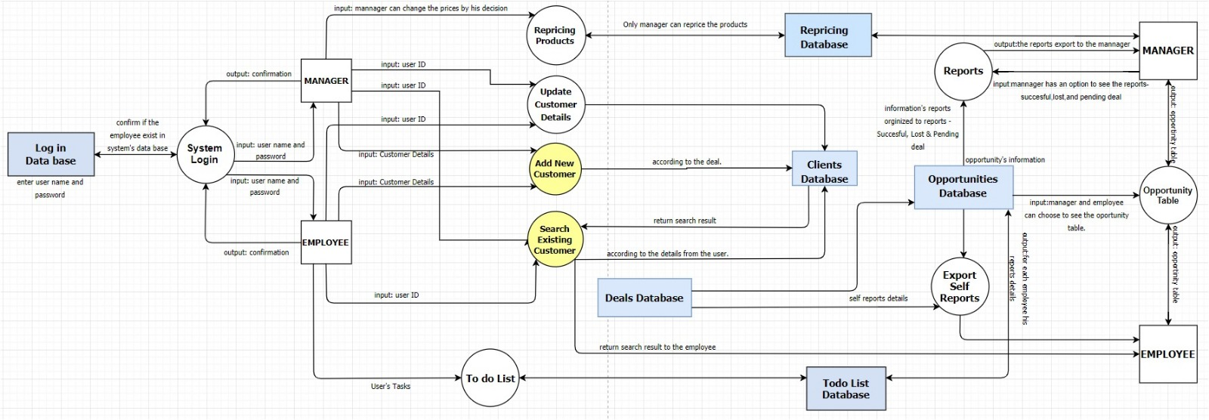
DFD

Slide 5
Various persisting bugs from the test cases:
Open/Closed | Priority | Bug details | Action | System function
Open | Low | After the addition of a customer expected character is not added | First letter is not saving into the database | Adding customer
Closed | High | When the customer is added deal type stays blank | Type of a deal is not saved into database | Adding customer
Closed | Show stopper | When we would like to update customers status of a recently added customer the system crashes | Customer status can't be updated | Updating customer
Closed | Show stopper | Any change/update to the database initiates immediate system crash | Restarting the system after addition/removal to the database - system crashes | General
Open | Low | When we type an incorrect ID there is no error message | No error prompt on wrong ID | Searching
Closed | Medium | After the call to print reports, returns details with missing information such as total No. deals, and identifiers | Calling reports lead to print with missing information | Reports
Closed | High | Updating payment details type, the linked deal is not updating | Updating payment details error | Updating customer
Closed | High | When the customer cancels/changes the deal if its status is WON, it stays that way | Updating status of customer ins't updating | Updating customer

Slide 6
Main challenges of the test cases
Adding customer deal wouldn’t update the database – leads to printing bugs
01
Updating customer details - leads to system crash
02
Partially updating databases – leads to system crash
03

Slide 7
Unresolved challenges of the software
Ability to return to a customer in To-do list when the deal is either pending or lost
01
Prompts for wrong input in various stages
02

Slide 8
Risks involved:
The system utilizes various databases which lack encryption and have to be carefully stored in high security servers. If one of the databases will crash – the system will subsequently crash too.
Learning curve in utilizing the software to its full potential: learning how to operate it, getting used to the workflow

